Slide 1
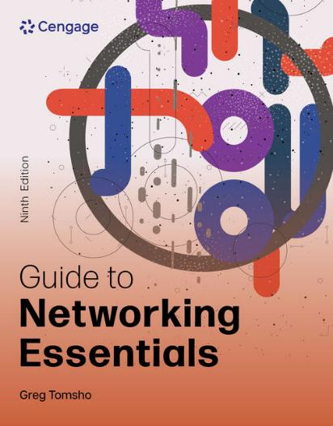
Guide to Networking Essentials, 9e
Chapter 6: IP Addressing
.

Slide 2
Chapter Objectives
By the end of this chapter, you should be able to:
Explain IPv4 addressing
Use Classless Interdomain Routing Notation
Perform subnetting calculations
Configure IPv4 addresses
Describe Network Address Translation
Describe IPv6
Explain IPv6 autoconfiguration and IPv4 transitioning methods

Slide 3
IPv4 Addressing (1 of 2)
An IPv4 address is a 32-bit number divided into four 8-bit values called octets, each octet can have a value from 0 to 255
Four decimal numbers are separated by periods in a format called dotted decimal notation
Subnet masks are also 32-bit numbers, that are used to determine how many bits are allocated to a network ID, and how many are allocated to a host ID
When written in binary, 1’s in the subnet mask that correspond to bits in the IP address mean the matching bit locations are part of the network ID

Slide 4
IPv4 Addressing (2 of 2)
Example:
192.168.14.250 = 11000000.10101000.0001110.11111010 255.255.255.0 = 11111111.11111111.11111111.00000000
The example above shows 192.168.14.0 as the network ID and 250 as the host ID

Slide 5
Binary Math (1 of 8)
How is the subnet mask used to determine the network ID?
Computers determine the network ID by doing a logical AND operation between its IP address and subnet mask
A logical AND is an operation between two binary values
AND operations can have the following results:
0 AND 0 = 0
1 AND 0 = 0
0 AND 1 = 0
1 AND 1 = 1

Slide 6
Binary Math (2 of 8)
The logical AND operation between a computer’s IP address and subnet mask looks like this:
10101100.00011111.01100100.00000110 (binary for 172.31.100.6)
AND
11111111.11111111.00000000.00000000 (binary for 255.255.0.0)
____________________________
10101100.00011111.00000000.00000000 (binary for 172.31.0.0)

Slide 7
Binary Math (3 of 8)
Review how the decimal number system works
0 through 9 are used to represent any possible number
Each place in a decimal number can have 10 possible values
The ones place can be expressed as a number 0 through 9, multiplied by 10 raised to the 0 power or 10⁰ (any number raised to the 0 power equals 1)
The decimal number 249 can be expressed as either of the following:
(2 * 10² ) + (4 * 10¹ ) + (9 * 10⁰ ) = 249
(2* 100 ) + (4 * 10 ) + (9 * 1 ) = 249

Slide 8
Binary Math (4 of 8)
With binary arithmetic, there are only 2 possible values (1 or 0)
For example, using the same method you used to solve the decimal example, you can express the binary number 101 as either of the following. The numbers in bold are the binary digits.
(1 * 2² ) + (0 * 2¹ ) + (1 * 2⁰ ) = 5
(1 * 4 ) + (0 * 2 ) + (1 * 1 ) = 5

Slide 9
Binary Math (5 of 8)
To convert 125 to binary use Table 6-1 and follow the directions:
125 is less than 128, so you place a 0 in the column under the 128. The test number remains 125
125 is greater than 64, so you place a 1 in the column under the 64 and subtract 64 from 125, leaving your new test number as 61
61 is greater than 32, so you place a 1 in the column under the 32 and subtract 32 from 61, leaving your new test number as 29
29 is greater than 16, so you place a 1 in the column under the 16 and subtract 16 from 29, leaving your new test number as 13
Continued on the slide following Table 6-1

Slide 10
Binary Math (6 of 8)
Table 6-1 Decimal-to-binary conversion table
128 | 64 | 32 | 16 | 8 | 4 | 2 | 1
2⁷ | 2⁶ | 2⁵ | 2⁴ | 2³ | 2² | 2¹ | 2⁰
0 | 1 | 1 | 1 | 1 | 1 | 0 | 1

Slide 11
Binary Math (7 of 8)
To convert 125 to binary use Table 6-2 and follow the directions (continued):
13 is greater than 8, so you place a 1 in the column under the 8 and subtract 8 from 13, leaving your new test number as 5
5 is greater than 4, so you place a 1 in the column under the 4 and subtract 4 from 5, leaving your new test number as 1
1 is less than 2, so you place a 0 in the column under the 2
1 is equal to 1, so you place a 1 in the column under the 1 and subtract 1 from 1, leaving your new test number as 0. When your test number is 0, you’re done

Slide 12
Binary Math (8 of 8)
The easiest way to convert an 8-digit binary number is to use Table 6-3
Using the binary number 11010011, you get the following:
128+64+0+16+0+0+2+1 = 211
Table 6-2 Converting 11010011 to 211
128 | 64 | 32 | 16 | 8 | 4 | 2 | 1
2⁷ | 2⁶ | 2⁵ | 2⁴ | 2³ | 2² | 2¹ | 2⁰
1 | 1 | 0 | 1 | 0 | 0 | 1 | 1

Slide 13
IPv4 Address Classes (1 of 3)
IP Addresses are categorized in Classes A-E
Only IP addresses in the A, B, and C classes are available for host assignment
Class A address information:
The value of the first octet is between 1 and 127
An IP address registry assigns the first octet, leaving the last three octets to be assigned to hosts
This allows 24 bits of address space or 16,777,214 hosts per network address

Slide 14
IPv4 Address Classes (2 of 3)
Class B address information:
The value of the first octet is between 128 and 191
An IP registry assigns the first two octets, leaving the third and fourth octets to be assigned to hosts
Having two octets in the host ID allows 65,534 hosts per network address
Class C address information:
The value of the first octet is between 192 and 223
An IP address registry assigns the first three octets
These networks are limited to 254 hosts per network

Slide 15
IPv4 Address Classes (3 of 3)
Class D addresses (224-239) are reserved for multicasting
Class E addresses (240-255) are reserved for experimental use and can’t be used for address assignment
Host address space is the total number of addresses in an IP network number that can be assigned to hosts
Loopback address refers to the local computer and is used to test the functioning of TCP/IP on the local computer

Slide 16
Private IP Addresses
A series of addresses have been reserved for private networks
Reserved addresses:
Class A addresses beginning with 10
Class B addresses from 172.16 to 172.31
Class C addresses from 192.168.0 to 192.168.255
The addresses in those ranges can’t be routed across the Internet
If access to the Internet is necessary, a process called Network Address Translation (NAT) is used
NAT will be explained later in the chapter

Slide 17
Classless Interdomain Routing
Classless Interdomain Routing (CIDR) is a type of address configuration where subnet masks could be configured regardless of the address class
The use of IP addresses with their default subnet masks is referred to as classful addressing
With CIDR, you could assign the IP address of 172.31.210.10 with a subnet mask of 255.255.255.0
In this case 172.31.210.0 would be the network ID and .10 would be the host ID

Slide 18
CIDR Notation
CIDR notation uses the format A.B.C.D/n where n is the number of 1 bits in the subnet mask
This number is also referred to as the IP prefix
Example:
172.31.210.10 with a 255.255.255.0 subnet mask is expressed as 172.31.210.10/24 in CIDR notation
The network ID is 24 bits, leaving 8 bits for the host ID

Slide 19
Broadcast Domains
A broadcast domain defines which devices must receive a packet that’s broadcast by any other device
TCP/IP communication relies heavily on broadcast packets
DHCP and ARP use broadcasts to perform their tasks
Every time a computer receives a broadcast packet, the NIC generates an interrupt, causing the CPU to stop what it’s doing and read the packet
If the broadcast is not relevant to the computer, the packet is discarded

Slide 20
IPv4 Subnetting
A subnet is a subdivision of an IP network address space
Subnetting is a process that reallocates bits from an IP address’s host portion to the network portion, creating multiple smaller address spaces
Reasons to subnet:
To divide a very large network into many smaller subnetworks
To conserve IP addresses
To divide a network into logical groups

Slide 21
Calculating a Subnet Mask (1 of 4)
To divide a large network into smaller subnets, follow this process:
Decide how many subnets you need
Each router interface connection indicates a required subnet
Decide how many bits you need to meet or exceed the number of required subnets
Use the formula 2^{n}, with n representing the number of bits you must reallocate from the host ID to the network ID
The number of subnets you create is always a power of 2, so if you need 20 subnets, you must reallocate 5 bits (2⁵ = 32), reallocating 4 bits gives you only 16 subnets

Slide 22
Calculating a Subnet Mask (2 of 4)
To divide a large network into smaller subnets, follow this process (continued):
Reallocate bits from the host ID, starting from the most significant host bit (that is, from the left side of the host ID)
You must also ensure that you have enough host bits available to assign to computers on each subnet
To determine the number of host addresses available, use the formula 2^{n} - 2, with n representing the number of host (0) bits in the subnet mask.

Slide 23
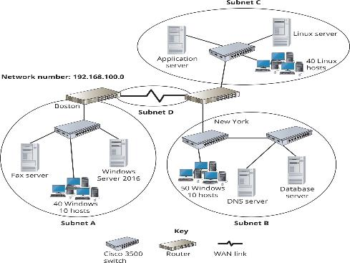
Calculating a Subnet Mask (3 of 4)
Figure 6-2 A sample network for calculating subnet mask
requirements

Slide 24
Calculating a Subnet Mask (4 of 4)
To find out what prefix to assign an IP network based on the number of host addresses required for the network:
Determine how many host bits are needed to support the number of hosts specified
Subtract this number from the number of network bits
For example, for a network ID 172.16.16.0 that will support 60 hosts:
You need 6 bits for the host ID because 2⁶ = 64
The prefix is 32 – 6 = 26
CIDR notation would be 172.16.16.0/26

Slide 25
Supernetting (1 of 2)
Supernetting is sometimes necessary to solve certain network configuration problems and to make routing tables more streamlined
Supernetting reallocates bits from the network portion of an IP address to the host portion
Making two or more smaller subnets a larger supernet
Route aggregation or summarization can combine multiple routing table entries into a single entry
This can drastically decrease the table’s size on Internet routers and increase routers’ speed and efficiency

Slide 26
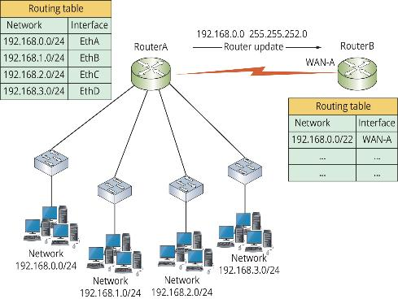
Supernetting (2 of 2)
Figure 6-3 RouterA sends a summary of its routing table to RouterB

Slide 27
Knowledge Check Activity 6-1
What type of device does not forward broadcast and creates broadcast domains?
a. Router
b. Hub
c. VPN
d. Switch

Slide 28
Knowledge Check Activity 6-1: Answer
What type of device does not forward broadcast and creates broadcast domains?
Answer: a. Router
Explanation: A broadcast domain defines which devices must receive a packet that’s broadcast by any other device, and each port on a router constitutes a broadcast domain because routers don’t forward broadcast packets. Hubs and switches forward broadcasts and a VPN creates a secure connection between devices across an unsecure network.

Slide 29
Configuring IPv4 Addresses (1 of 2)
Rules for IP address assignment:
A host can be assigned only a Class A, Class B, or Class C address
Every IP address configuration must have a subnet mask
All hosts on the same physical network must share the same network ID in their IP addresses
All host IDs on the same network must be unique

Slide 30
Configuring IPv4 Addresses (2 of 2)
Rules for IP address assignment (continued):
You can’t assign an IP address in which all the host ID bits are binary 0
You can’t assign an IP address in which all the host ID bits are binary 1
Computers assigned different network IDs can communicate only if a router is present to forward packets
The default gateway address assigned to a computer must have the same network ID as that computer

Slide 31
Configuring Multiple IP Addresses
Part 2
Windows OSs allow assigning multiple IP addresses to a single network connection, via Advanced TCP/IP Settings dialog box
Multiple IP addresses can be useful in these situations:
The computer is hosting a service that must be accessed by using different addresses
The computer is connected to a physical network that hosts multiple IP networks

Slide 32
Configuring the Default Gateway (1 of 4)
A default gateway tells the computer where packets destined for another network can be sent
The default gateway’s address must have the same network ID as the host
Multiple gateways can be configured
Windows attempts to select the gateway with the best metric automatically
A metric is a value assigned to the gateway based on the speed of the interface used to access the gateway

Slide 33
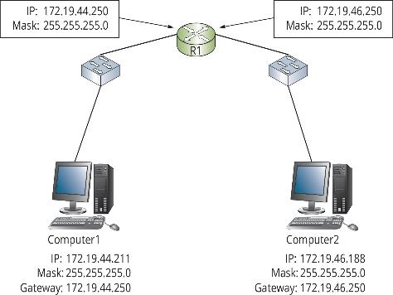
Configuring the Default Gateway (2 of 4)
Figure 6-5 Determining the destination computer’s network address with the subnet mask

Slide 34
Configuring the Default Gateway (3 of 4)
A multihomed server has two or more NICs, each attached to a different IP network
Each NIC requires its own IP address for the network to which it’s connected
Reasons for this type of configuration include the following:
A server is accessed by internal clients and external clients
A server provides resources for computers on multiple subnets of the network
A server is configured as a router or VPN server

Slide 35
Configuring the Default Gateway (4 of 4)
Windows computers maintain a routing table that dictates where a packet should be sent, based on the packet’s destination address
Typing route print displays the routing table
Results are displayed in five columns:
Network Destination, Netmask, Gateway, Interface, and Metric
The route command can be used to change the routing table, and to fix issues caused by using a multihomed server

Slide 36
IP Configuration Command-Line Tools (1 of 3)
The netsh command can used for many tasks such as firewall and IP address configuration
To configure the IP address of an interface named Ethernet use this command:
netsh interface ipv4 set address “Ethernet” static 10.1.1.1 255.255.0.0
ipconfig is typically used to display a computers IP address settings
Can also be used to manage IP address settings

Slide 37
IP Configuration Command-Line Tools (2 of 3)
ping is used to test the connectivity between two computers, by sending an ICMP Echo Request packet
If the destination receives the ICMP Echo Request and can respond, it will reply with an ICMP Echo Reply packet
Example: Reply from 192.168.100.201 bytes=32 time=<1ms TTL=128
The arp command displays or makes changes to the Address Resolution Protocol (ARP) cache
-a or -g: displays current ARP entries
-d: deletes ARP entries

Slide 38
IP Configuration Command-Line Tools (3 of 3)
tracert displays the route packets take between two computers
tracert works by sending out packets with a TTL value starting at 1 and increases the value until the destination is reached
This command is useful for troubleshooting the routing topology of a complex network and finding bottlenecks
nslookup is used to test and troubleshoot DNS operation
nslookup can be used in command mode or interactive mode
In command mode, type nslookup host to query for the host’s address
In interactive mode, you can simply type host to get the host’s address

Slide 39
Network Address Translation (1 of 4)
Network Address Translation (NAT) allows an organization to use private IP addresses while connected to the Internet
The NAT process translates a workstation’s private address (as a packet leaves the corporate network) into a valid public Internet address
When data returns to the workstation, the address is translated back to the original private address
NAT is usually handled by a network device connected to the Internet, such as a router
Address translation is kept track of in a NAT table

Slide 40
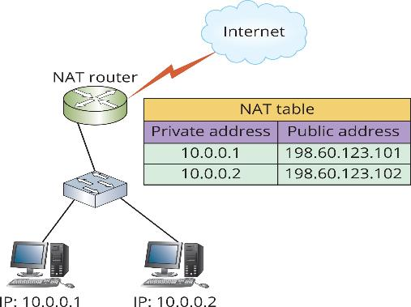
Network Address Translation (2 of 4)
Figure 6-8 Private addresses translated to public addresses with NAT

Slide 41
Network Address Translation (3 of 4)
Port Address Translation (PAT) allows several hundred workstations to access the Internet with a single public Internet address
Each packet contains source and destination IP addresses along with source and destination port numbers
A single public IP address is used for all workstations, but different source port numbers are used for each communication session

Slide 42
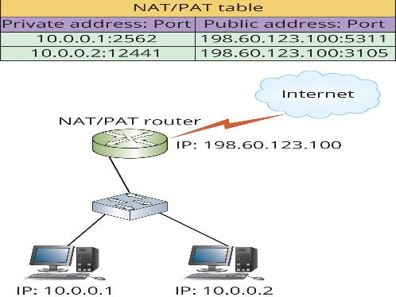
Network Address Translation (4 of 4)
Figure 6-9 PAT uses the port number to allow using a single public IP address

Slide 43
Internet Protocol Version 6
IPv6 is the replacement for IPv4
IPv6 addresses look very different from IPv4 addresses
They have fields with a distinct purpose
Configuring an IPv6 address is distinctly different from configuring an IPv4 address

Slide 44
IPv6 Address Structure (1 of 2)
IPv6 uses 128 bits, instead of IPv4’s 32 bits, for an address
IPv6 addresses are written as eight 16-bit hexadecimal numbers separated by colons:
fe80:0:0:0:18ff:0024:8e5a:60
Things to note about IPv6 addresses:
One or more consecutive 0 values can be written as a double colon, but only one double colon can exist in an IPv6 address
Leading 0s are optional (the value 0024 above could be written as 24)
Hexadecimal numbers are easier to convert to binary

Slide 45
IPv6 Address Structure (2 of 2)
The interface ID of an IPv6 is 64 bits and uses the interface’s 48-bit MAC address, as well as a 16-bit value of FF-FE that is inserted after the first 24 bits of the MAC address
An IPv6 interface ID can be assigned to a host in these ways:
Using the 48-bit MAC address
A randomly generated permanent interface identifier
A temporary interface identifier
Via DHCPv6
Manually

Slide 46
IPv6 Address Types (1 of 2)
IPv6 defines the following address types: unicast, multicast, and anycast
A unicast address specifies a single interface on a device
Three primary types of unicast addresses:
Link-local addresses can’t be routed
Unique local addresses are for use behind a firewall and are preconfigured on routers
Global unicast addresses are accessible on the public Internet and can be routed

Slide 47
IPv6 Address Types (2 of 2)
IPv6 Special-Purpose Addresses
Loopback address is equivalent to 127.0.0.1 used in IPv4 and is written as ::1
Zero address is used as a placeholder in the source address field of an outgoing IPv6 packet and is written as ::
Documentation—the global unicast address 2001:db8::/32 has been reserved for use in books and other documentation discussing IPv6
IPv4-to-IPv6 transition—several address prefixes are used for transitioning from IPv4 to IPv6

Slide 48
Subnetting with IPv6 (1 of 2)
Subnetting will still exist in IPv6, but due to the large address space available, most address allocations will have a /48 prefix
This means the network ID is 48 bits, and the network administrator has 80 bits for assigning subnets and host IDs
80 bits allows 16 subnet bits (since the interface ID requires 64 bits), allowing up to 65,536 subnets

Slide 49

Subnetting with IPv6 (2 of 2)
Figure 6-10 Structure of a typical IPv6 address

Slide 50
IPv6 Multicast Addresses
A multicast address in IPv6 performs the same function as its counterpart in IPv4
Multicast addresses begin with ff and have the following structure:
ffxy:zzzz:zzzz:zzzz:zzzz:zzzz:zzzz:zzzz
Flags—4-bit field, indicated by the x, uses the three low-order bits
Scope—indicated by the y, specifies whether and where the multicast packet can be routed
Group ID—represented by the z characters, identifies a multicast group

Slide 51
Anycast Addresses
Anycast addresses can be assigned to multiple interfaces on different nodes
Anycast addresses don’t have a special format
They are used when there are multiple nodes providing the same service and the client computer doesn’t care which device actually provides the service
Services that benefit from using anycast addresses include DNS servers, content delivery networks (CDNs), and web servers

Slide 52
IPv6 Autoconfiguration and IPv4 Transitioning Methods
IPv6 autoconfiguration occurs by two methods:
Stateless autoconfiguration—the node listens for router advertisement messages from a local router
Stateful autoconfiguration—the node uses an autoconfiguration protocol, such as DHCPv6, to obtain its IPv6 address and other configuration information

Slide 53
Autoconfiguration on Windows Hosts
The Windows autoconfiguration steps:
At initialization, a link-local address is determined
The link-local address is verified using duplicate address detection
If the address is verified as unique, address is assigned to the interface
The host transmits a router solicitation message
If no router advertisement messages are received in response to the solicitation message, the host attempts to use DHCPv6 to get an address
If router advertisement message is received, the prefix in the message is used along with interface ID to configure the IPv6 address

Slide 54
Transitioning from IPv4 to IPv6 (1 of 5)
A dual IP layer architecture means that the computer can communicate directly with both IPv4 and IPv6 devices by using the native packet types
Computers running either architecture can encapsulate IPv6 packets in an IPV4 header, a process called “tunneling”
Tunneling is a network protocol technique that allows transmitting a packet in a format that’s incompatible with the network architecture by encapsulating the packet in a compatible header format
It’s needed when packets must traverse a network in which their protocol isn’t used

Slide 55
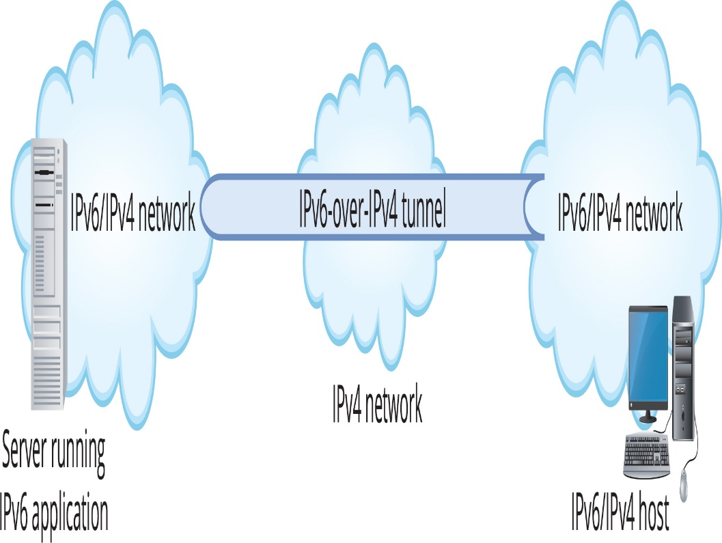
Transitioning from IPv4 to IPv6 (2 of 5)
Figure 6-12 IPv6-over-IPv4 tunneling

Slide 56
Transitioning from IPv4 to IPv6 (3 of 5)
Intra-Site Automatic Tunnel Addressing Protocol (ISATAP) is used to transmit IPv6 packets between dual IP layer hosts across an IPv4 network
ISATAP addresses have the following format:
fe80::5efe:n:n:n:n
The first 64 bits of an ISATAP address are the link-local IPv6 address fe80 followed by 48 0 bits and the next 16 bits are typically 5efe
ISATAP embeds the IPv4 address in the last 32 bits of the IPv6 address

Slide 57
Transitioning from IPv4 to IPv6 (4 of 5)
6to4 provides automatic tunneling of IPv6 traffic over an IPv4 network
It can provide host-to-router or router-to-host tunneling but is most often used to create a router-to-router tunnel
The key to 6to4 tunneling is the 2002::/16 prefix
Routers configured to perform 6to4 tunneling recognize the 2002 prefix as a 6to4 address
The IPv4 address embedded in the 6to4 address must be a public address, which limits its use

Slide 58
Transitioning from IPv4 to IPv6 (5 of 5)
Teredo is an automatic IPv6-over-IPv4 tunneling protocol that solves the problem of 6to4’s requirement of a public IPv4 address
A Teredo address has the following format:
2001:tttt:tttt:gggg:pppp:xxxx:xxxx
The first 16 bits are always the Teredo prefix 2001
The next 32 bits are the Teredo server’s IPv4 public address
The next 16 bits are Teredo flags that specify processing options
The p characters represent an obscured UDP port the client uses for Teredo traffic
The last 32 bits are the IPv4 address the client uses for Teredo traffic

Slide 59
Knowledge Check Activity 6-2
When does a computer send a packet to its default gateway?
a. When the ARP broadcast did not receive a reply.
b. When the destination address has a different network ID than its own network ID.
c. When the destination address has a different host ID than its own host ID.
d. When the destination address can’t be found by a DNS lookup.

Slide 60
Knowledge Check Activity 6-2: Answer
When does a computer send a packet to its default gateway?
Answer: b. When the destination address has a different network ID than its own network ID.
Explanation: When a computer has a packet in which the network ID of the destination IP address is different than its own network ID, that means that the destination device is on a different network and the host must send the packet to the default gateway so the packet can be routed to the correct network.

Slide 61
Self Assessment
Explain the differences between an IPv4 address and an IPv6 address.
Name some reasons why a network administrator may need to subnet a network.

Slide 62
Summary
Now that the lesson has ended, you should be able to:
Explain IPv4 addressing
Use Classless Interdomain Routing Notation
Perform subnetting calculations
Configure IPv4 addresses
Describe Network Address Translation
Describe IPv6
Explain IPv6 autoconfiguration and IPv4 transitioning methods

